Slide 1
IRS Form 1040

Slide 2
IRS Form 1040
We file 1040 forms, not 1040A, 1040EZ, etc.
1040 is split up into 4 general areas
  Taxpayer information
  Income
  Taxes & Credits
  Payments/Refunds Due and Signature

Slide 3
Taxpayer Information
Includes:
  Personal information for taxpayer & spouse
  Presidential election campaign question
  Filing status (lines 1– 5)
  Exemptions, including Dependents (lines 6a-d)
Input into TaxWise on the Main Information Screen

Slide 4
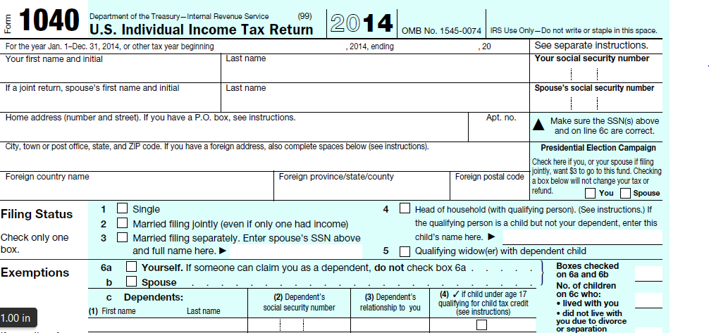
Form 1040 Page 1 Taxpayer Info
Personal Information

Slide 5
Form 1040 Page 1 Taxpayer Info
Presidential Election Campaign

Slide 6
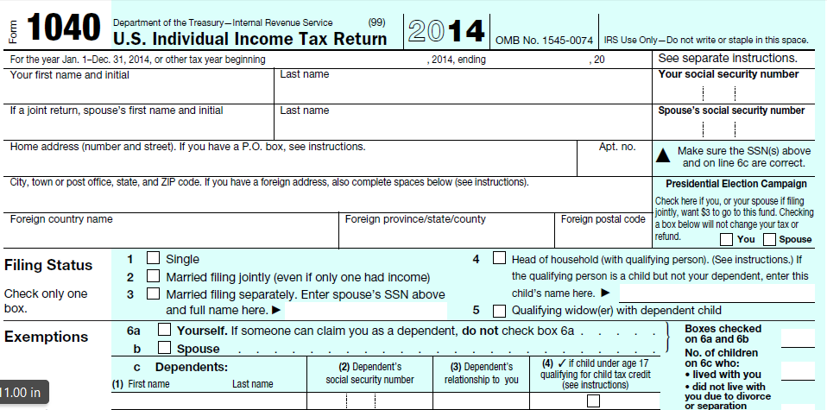
Form 1040 Page 1 Taxpayer Info
Filing Status

Slide 7
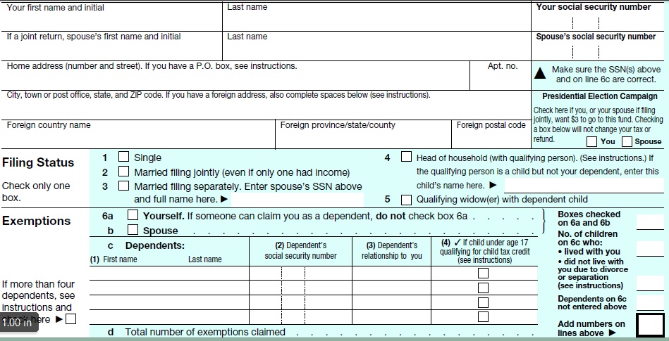
Form 1040 Page 1 Taxpayer Info
Exemptions (including Taxpayer, Spouse & Dependents)

Slide 8
Income
All sources of income included in this section (lines 7-22)
Income derived from various tax forms usually issued by employer, financial institution, government agency, etc
Information from tax forms and client interview entered into the respective form or worksheet in TaxWise
TaxWise puts the appropriate values into the 1040
Adjustments to income included in this section (lines 23-36)
Final line on page is “Adjusted Gross Income” (line 37)

Slide 9
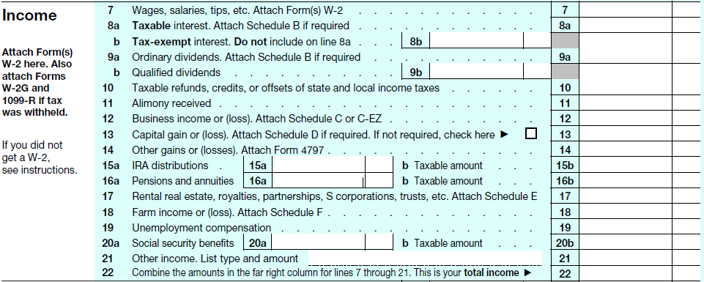
1040 Page 1 Income
Income

Slide 10
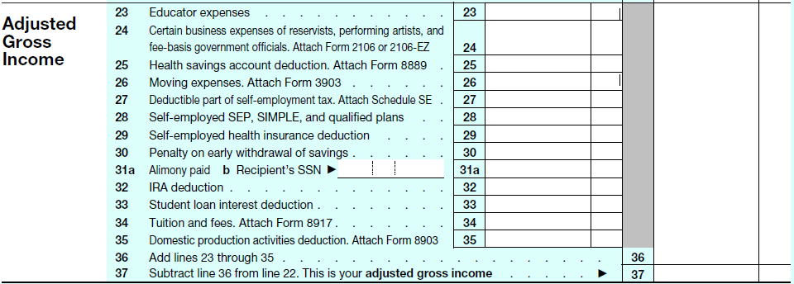
1040 Page 1 Adjustments to Income
Adjustments

Slide 11
1040 Page 1 Income
Adjusted Gross Income (AGI)

Slide 12
Taxes & Credits Page 2
Taxable Income
  Start with “Adjusted Gross Income” (line 38)
  Deduct Itemized or Standard Deductions (lines 39-41)
  Deduct Personal Exemptions (line 42)
  Arrive at “Taxable Income” (line 43)
Calculate Tax on “Taxable income” (line 44)
Total Tax
  Start with Calculated Tax on Taxable Income (line 44)
  Add any excess medical insurance premium aid received through the Affordable Care Act that has to be repaid (advance premium tax credits) (line 46)
  Deduct non-refundable tax credits (Credits that reduce tax up to zero dollars) (lines 48-55)
  Add other taxes due (lines 57-62)
  Bottom line is “Total Tax” (line 63)
Notes:
Discuss the difference between refundable and nonrefundable credits

Slide 13
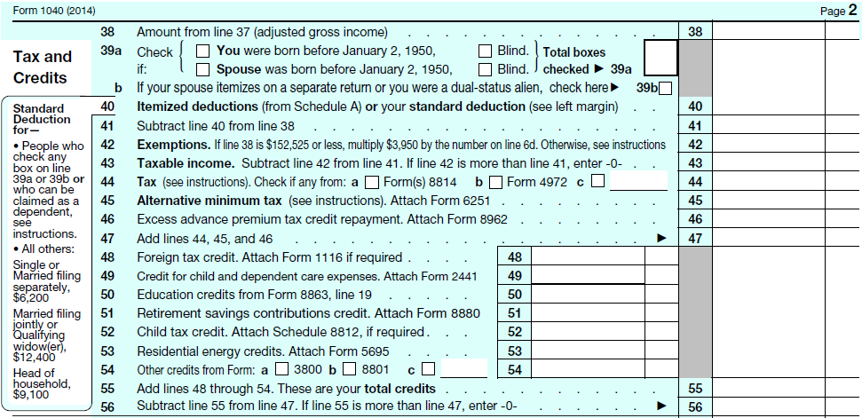
1040 Page 2 Taxes & Credits
Adjusted Gross Income (AGI)

Slide 14
1040 Page 2 Taxes & Credits
- Deduct Itemized or Standard Deductions

Slide 15
1040 Page 2 Taxes & Credits
- Deduct Exemptions

Slide 16
1040 Page 2 Taxes & Credits
= Arrive at Taxable Income

Slide 17
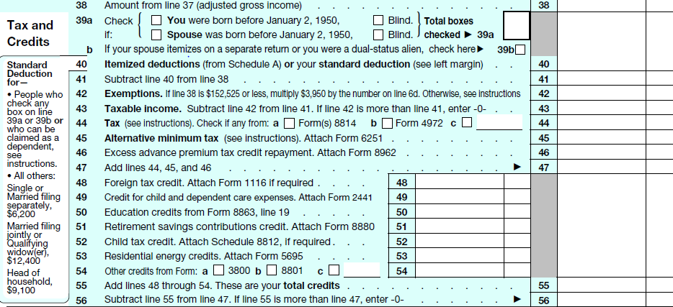
1040 Page 2 Taxes & Credits
Calculated Tax

Slide 18
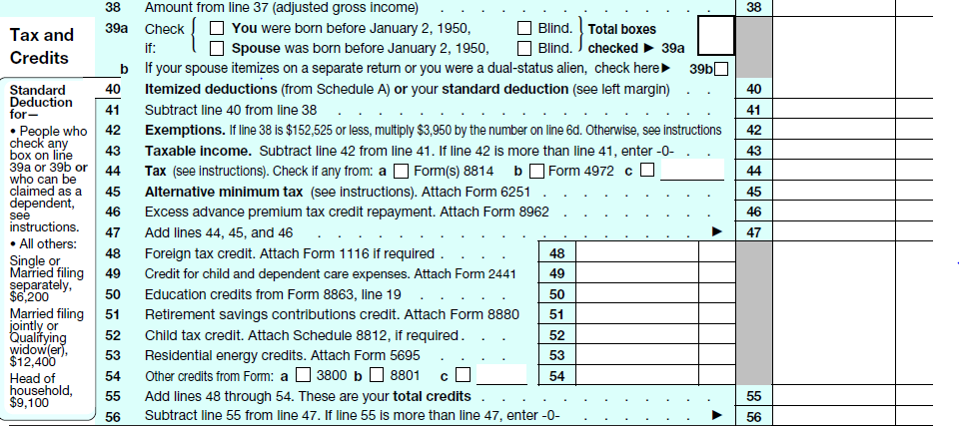
1040 Page 2 Taxes & Credits
+ Excess Advance Premium Tax Credit Repayment

Slide 19
1040 Page 2 Taxes & Credits
- Deduct Nonrefundable Credits

Slide 20
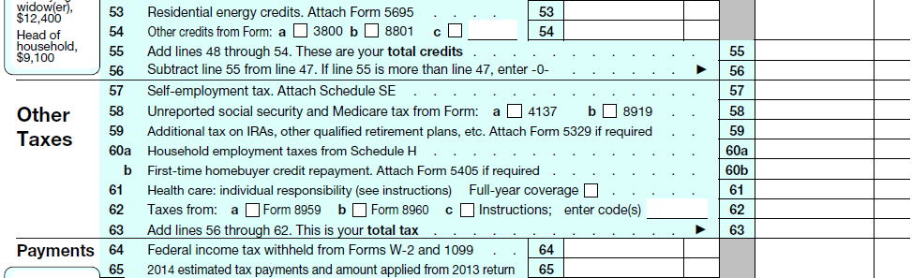
1040 Page 2 Taxes & Credits
+ Add Other Taxes

Slide 21
1040 Page 2 Taxes & Credits
= Bottom Line is “Total Tax”

Slide 22
Payments/Refund/Owe
Payments
  Apply tax withheld and estimated payments
  Add refundable credits (these credits can exceed the amount of the tax you owe and increase your refund)
  Total is your total payments
Subtract total payments from total tax
  If payments are greater than total tax, you are entitled to a refund
  If payments are less than total tax, you owe taxes

Slide 23
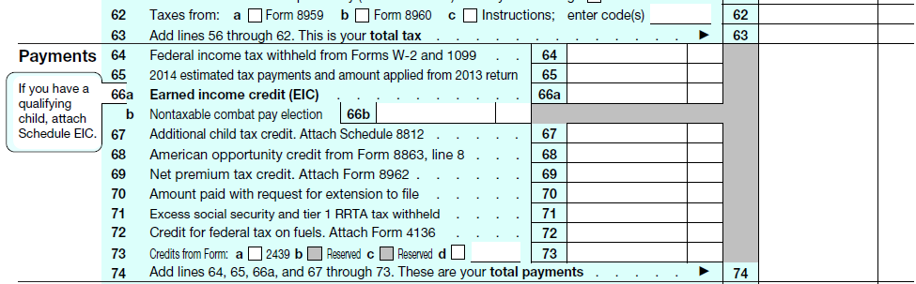
Payments/Refund/Owe
Apply tax withheld & estimated payments

Slide 24
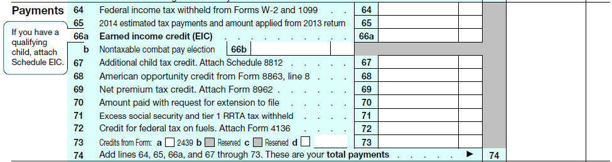
Payments/Refund/Owe
Apply refundable credits

Slide 25
Payments/Refund/Owe
= Total of all payments

Slide 26
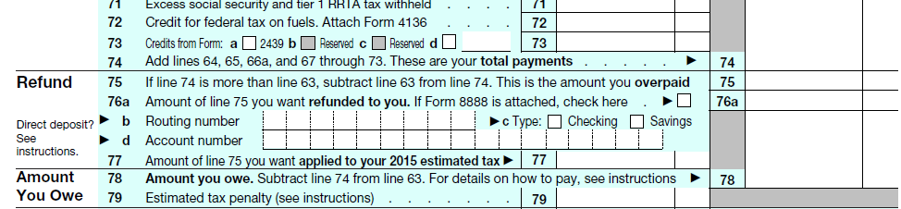
Payments/Refund/Owe
= Bottom Line (A refund / You owe)

Slide 27
Direct Deposit/ Sign
In the box below the refund is a spot for direct deposit information
Bottom of the form is the signature box

Slide 28
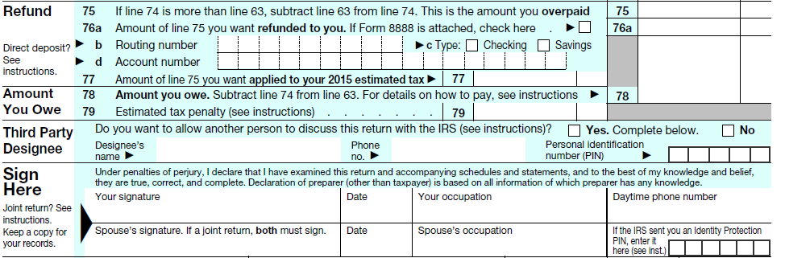
Direct Deposit/Sign
Direct Deposit information

Slide 29
Payments/Refund/Owe/Sign
Signature Line

